Slide 1
DANKEY KANG
Erica McCarty, Carson Mires, and Reece Palmer

Slide 2

Member Roles - Erica
Attempted to make all characters the same size
Converted characters from a Sprite Sheet into individual BMP files
Enlarge the game (dropped)
Fix excessive amounts of colors in a picture
Created the Start Screen
Made all backgrounds green in BMP files

Slide 3

Member Roles - Carson
Coded basic mechanics of the game
Created the Draw.h and Test.h header files
Converted RGB color values to actual colors
Attempted to make the characters move throughout the game
Attempted to enlarge the game
Drew BMP files with characters on them from the Sprite Sheet

Slide 4
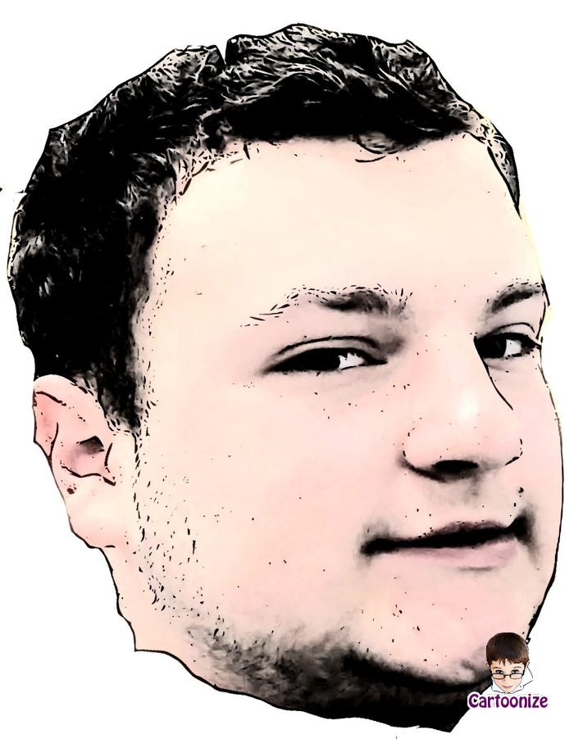
Member Roles - Reece
Conducted Research on how the game worked and what we needed to do
Helped load the BMP files into the game
Ran the RGB color converter to find actual colors instead of RGB number values

Slide 5
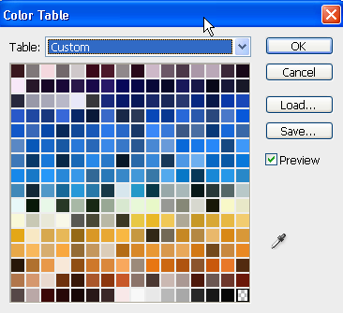
Difficulties We Experienced
Having thousands of colors to convert (Solution - Erica converted the RGB colors to index colors to cut down on the amount of them)
Game too small (Dropped)
Getting the characters to move (Attempted to split the characters into their own loops to run by themselves and not reliant on player input)

